Slide 1
Kernel Operations – Assignment 02 Graphics Programming
By Akarsh Kumar

Slide 2
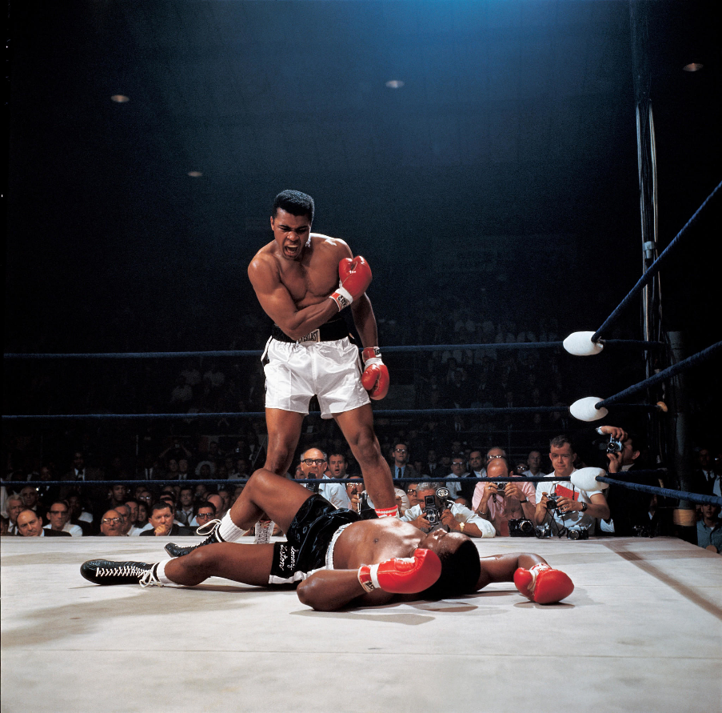

Images Chosen

Slide 3

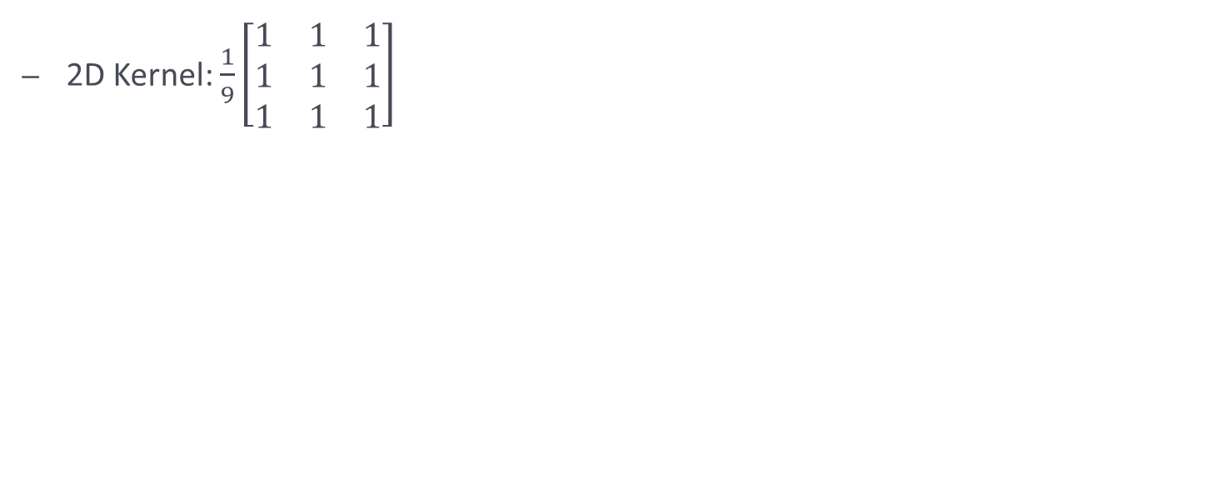
Box Blur
2D Kernel: $\frac{1}{9}\left[\begin{matrix}1 & 1 & 1 \\ 1 & 1 & 1 \\ 1 & 1 & 1\end{matrix}\right]$
pic_1_b.png

Slide 4
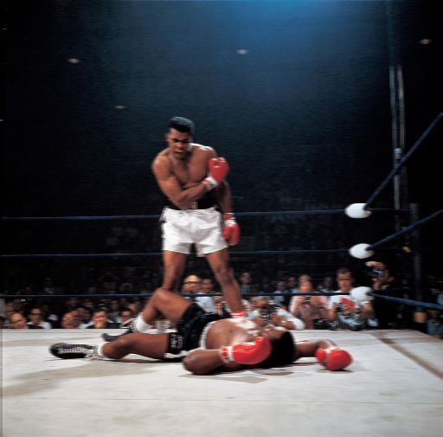

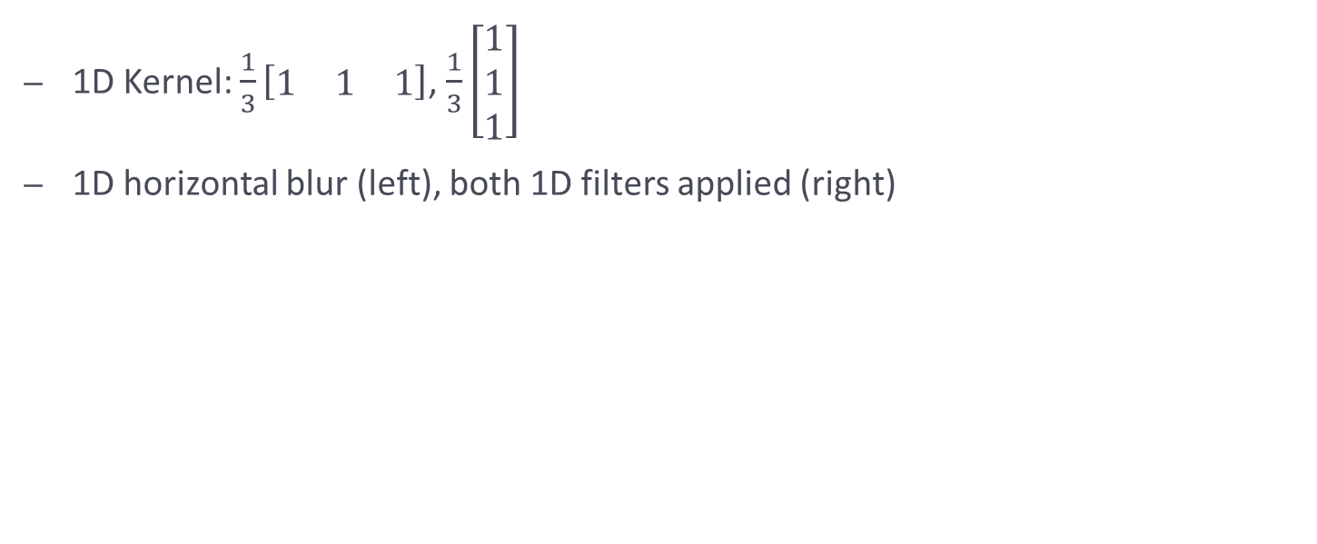
1D Blur
1D Kernel: $\frac{1}{3}\left[\begin{matrix}1 & 1 & 1\end{matrix}\right]$, $\frac{1}{3}\left[\begin{matrix}1 \\ 1 \\ 1\end{matrix}\right]$
1D horizontal blur (left), both 1D filters applied (right)
pic_1_d_0.png
pic_1_d_0.png

Slide 5

1D Blur vs Box Blur
The following is the normalized version of the difference between two 1 dimensional blurs and the single 2 dimensional blur
Average of absolute value of difference: 10.973
Normalized difference:
pic_1_e.png

Slide 6

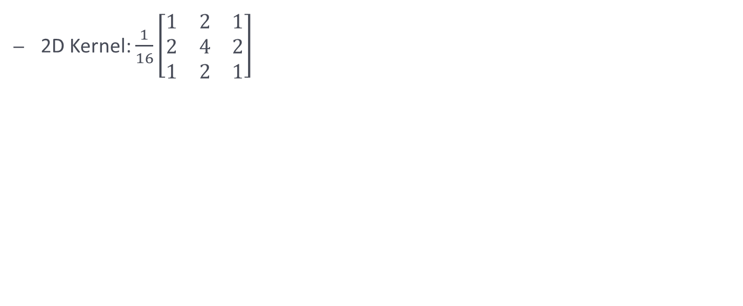
Gaussian Blur
2D Kernel: $\frac{1}{16}\left[\begin{matrix}1 & 2 & 1 \\ 2 & 4 & 2 \\ 1 & 2 & 1\end{matrix}\right]$
pic_2_b.png

Slide 7


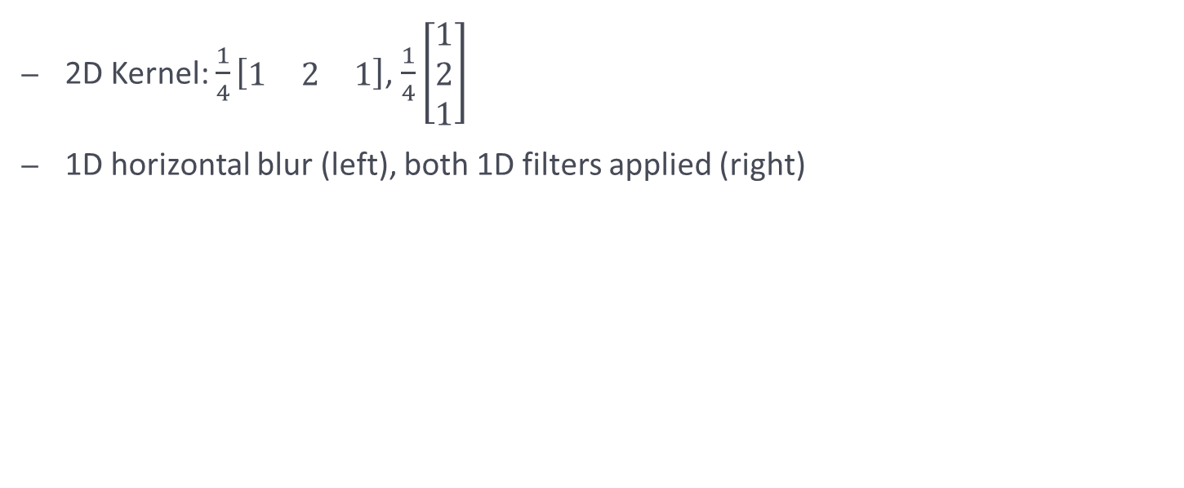
1D Gaussian Blur
2D Kernel: $\frac{1}{4}\left[\begin{matrix}1 & 2 & 1\end{matrix}\right]$, $\frac{1}{4}\left[\begin{matrix}1 \\ 2 \\ 1\end{matrix}\right]$
1D horizontal blur (left), both 1D filters applied (right)
pic_2_d_0.png
pic_2_d_1.png

Slide 8

1D Gaussian vs 2D Gaussian
Average of absolute value of difference: 16.734
Normalized difference:
pic_2_e.png

Slide 9
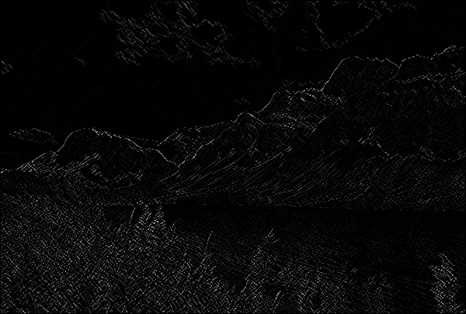
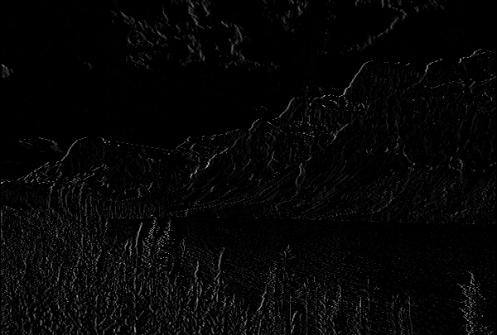
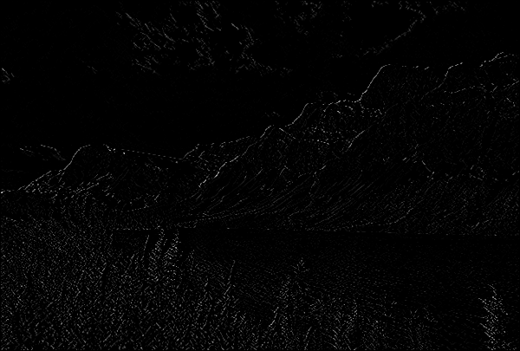
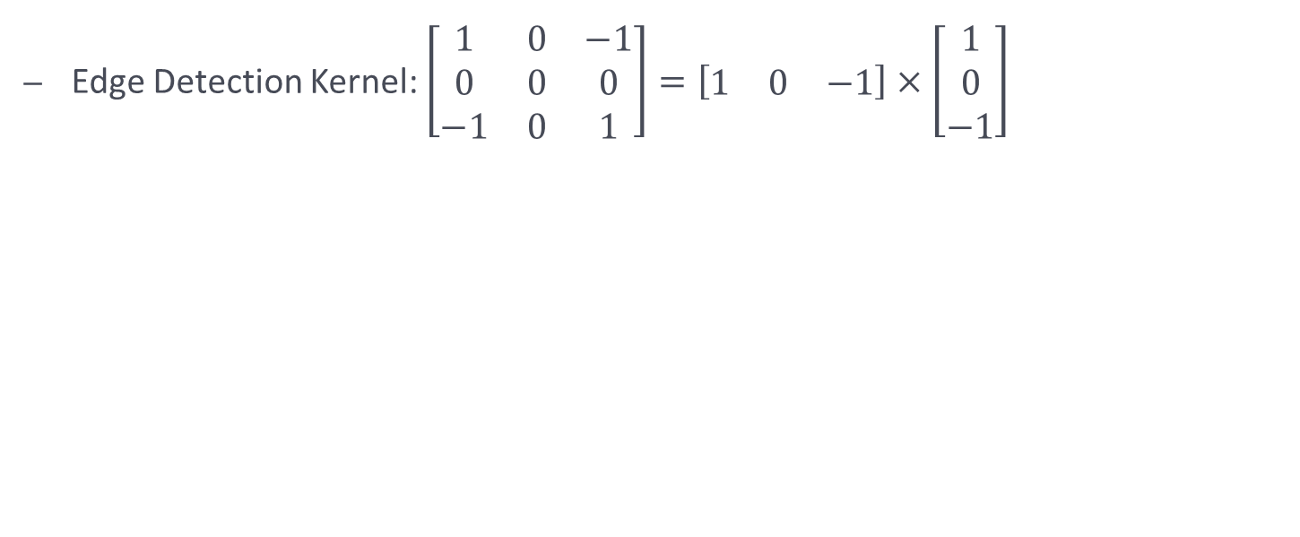
Edge Detection
Edge Detection Kernel: $\left[\begin{matrix}1 & 0 & −1 \\ 0 & 0 & 0 \\ −1 & 0 & 1\end{matrix}\right]=\left[\begin{matrix}1 & 0 & −1\end{matrix}\right]×\left[\begin{matrix}1 \\ 0 \\ −1\end{matrix}\right]$
pic_3_b.png
pic_3_d_0.png
pic_3_d_1.png

Slide 10

Diagonal Edge Detection vs Two 1Dimensional Edge Detection
Average absolute value of difference: 3.853
Normalized difference:
pic_3_e.png

Slide 11
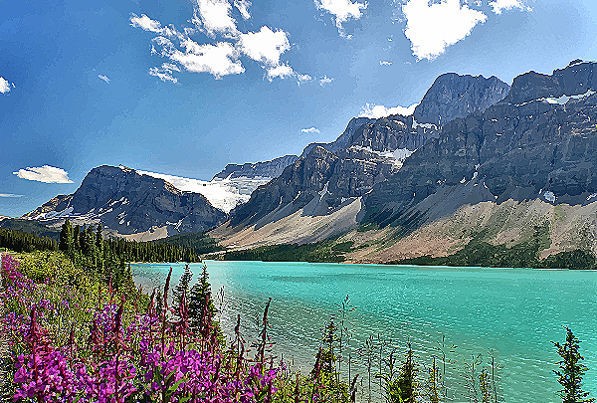

Sharpen Image
- Kernel: $\left[\begin{matrix}0 & −1 & 0 \\ −1 & 5 & −1 \\ 0 & −1 & 0\end{matrix}\right]$
pic_4_b.png

Slide 12
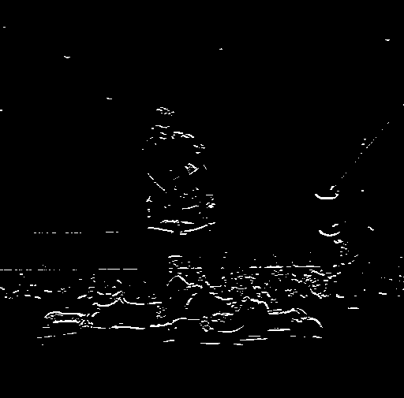
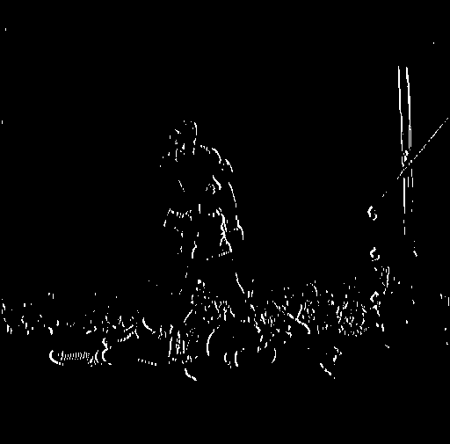

Corner Detection
- Corner detection was done by getting a horizontal edge detection (left) and a vertical edge detection (middle) and using a black white filter on those and using that to find common points in both and outlining the corners (right)

